Slide 1
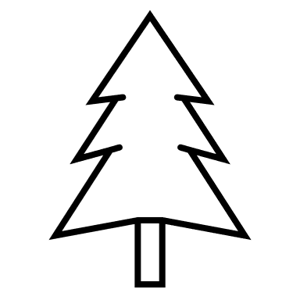
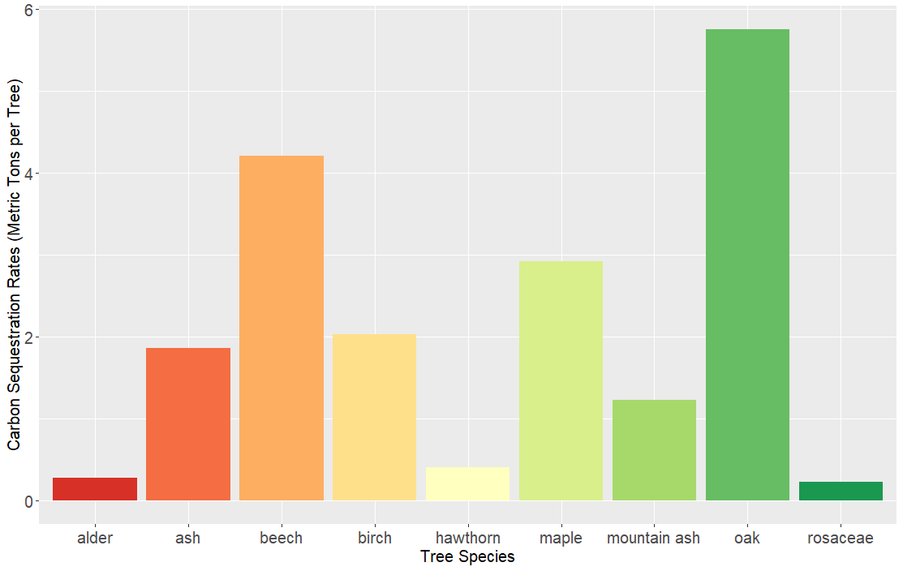
Species vs Sequestration:
A Study based on the Effect of
Tree Species on Carbon Sequestration Rates in Farlow Wood, N.Ireland
Shauna Conaghan BSc (Hons) Contact: sconaghan03@qub.ac.uk
Roe Valley Ancestral Researchers School of Biological Sciences, Queen’s University Belfast, Northern Ireland
What is Carbon Sequestration?
“The process of capturing and securing carbon storage, that if it was not stored it would, in turn, be released to, or persist in the Earth’s atmosphere.”
10.9 MILLION TONNES
CARBON SEQUESTERED IN UK IN 2020 [1]
AIMS
Identify tree species using leaves.
Determine if species is soft or hardwood.
Carbon sequestration can be carried out by both above-ground biomass and below-ground soils which will link together and form a large carbon pool. [2]
Sequestration is essential to reducing the global CO₂ levels as they reach an ultimate high of 407.4 ± 0.1ppm in 2018. [3]
There is many factors that affect the rates including age and soil composition. This study focusses on tree species.
AIMS
To calculate the carbon sequestration rate in Farlow Wood and determine if this rate is affected by species of tree.
Using a measuring tape, measure the circumference at 1m.
Convert this to diameter.
Tree species does not have an effect on carbon sequestration rates.
Tree species does have an effect on carbon sequestration rates.
Use equations to calculate the carbon sequestration in metric tons.
INTRODUCTION
HYPOTHESIS
METHODS
CONCLUSIONS
RESULTS
Carbon Sequestration Rates (Metric Tons per tree) for Each Tree Species
RESULTS
Results show that species does have an effect on sequestration rates and with the analysis being statistically significant we can accept the alternative hypothesis.
Difference can be due to many factors: Above-ground biomass amounts. The larger above-ground biomass amount, the higher the carbon sequestration rate due to more pores on leaves, stems etc. [4}
Other factors include different species have different leaf emergence rates i.e. some may be earlier than others therefore having longer to sequester.[5]
6
Oak
Farlow Wood has sequestered a total of 2403.285Mg.
Oak species have the highest rate with 5.75Mg per tree and Rosaceae has the lowest at 0.23Mg.
Following a one-way ANOVA: P < 3.54x10-15.
4
Beech
Carbon Sequestration Rates (Mg per Tree)
Maple
2
Ash
Birch
Mountain Ash
Alder
Hawthorn
Rosaceae
0
Tree Species
[1] Research, F. (2018) 'Carbon Sequestration
[2] Gren, I. and Aklilu, A. (2016) 'Policy design for forest carbon sequestration: A review of the literature', 70, pp. 128-136, Available: Forest Policy and Economics.
[3] Lindsey, R. (2020) 'Climate Change: Atmospheric Carbon Dioxide', Available: NOAA.
[4] Redondo-Brenes, A. and Montagnini, F. (2006) 'Growth, productivity, aboveground biomass, and carbon sequestration of pure and mixed native tree plantations in the Caribbean lowlands of Costa Rica', Forest Ecology and Management, 232(1), pp. 168-178.
[5] Chen, W., Black, T., Yang, P., Barr, A., Neumann, H., Nesic, Z., Blanken, P., Novak, M., Eley, J. and Ketler, R. (1999) 'Effects of climatic variability on the annual carbon sequestration by a boreal aspen forest', Global Change Biology, 5(1), pp. 41-53.

