Slide 1
Roe Valley Ancestral Researchers

Slide 2
The 1st Stumpery created from debris at the beginning of the trail

Slide 3
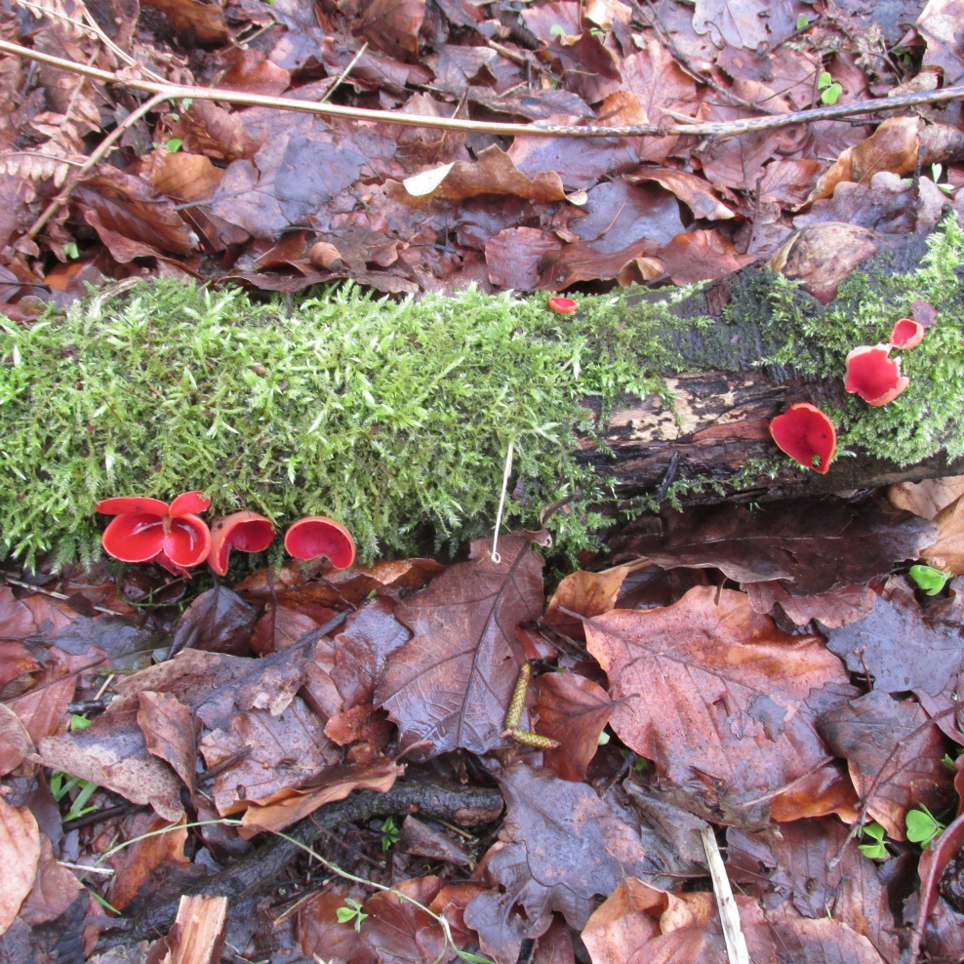
Springtime emerges in Farlow Wood

Slide 4
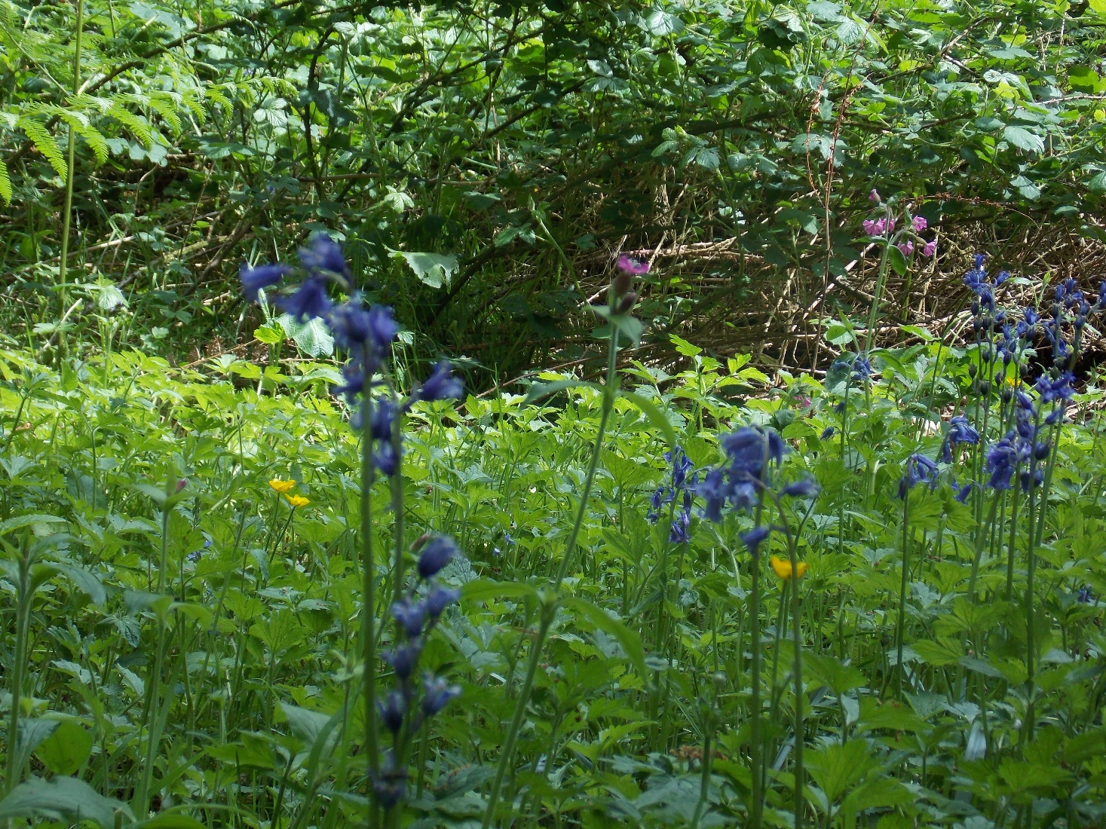
Bluebells Carpet the Woodland

Slide 5
Sampson’s Tower May 2020
Built in the 1860s as a Folly Memorial to Arthur Sampson JP for counties Londonderry & Tyrone and Agent of the worshipful Company of Fishmongers in Ballykelly
Research ongoing to find Architect, Stone Mason and those involved in the building of the Tower

Slide 6
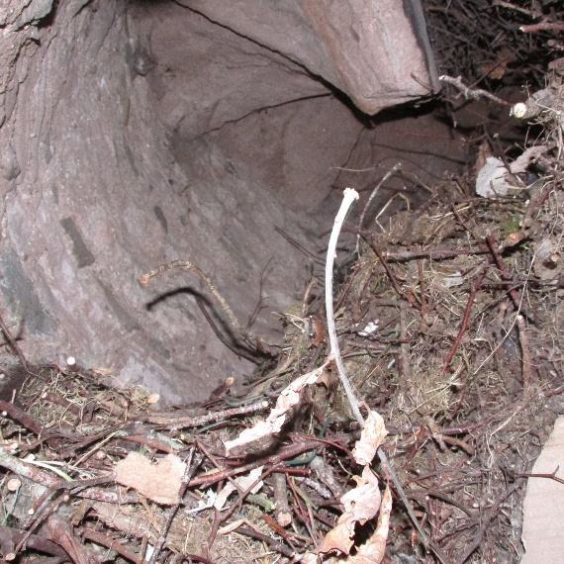
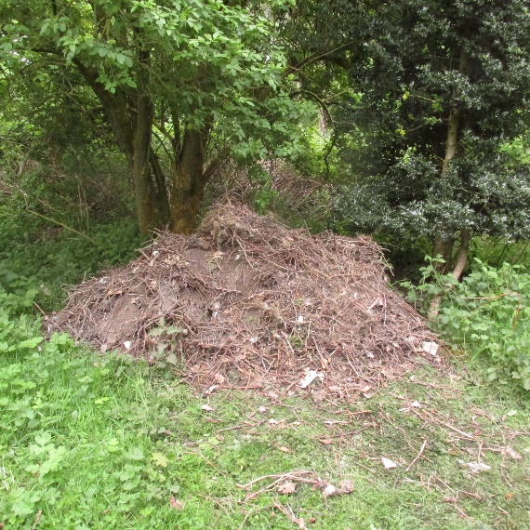
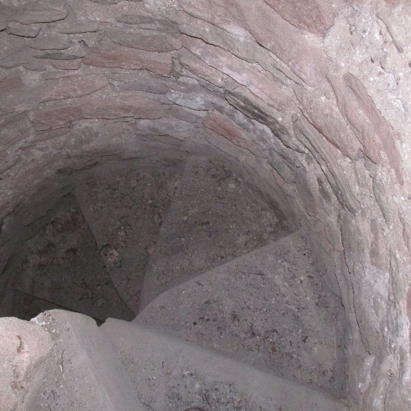
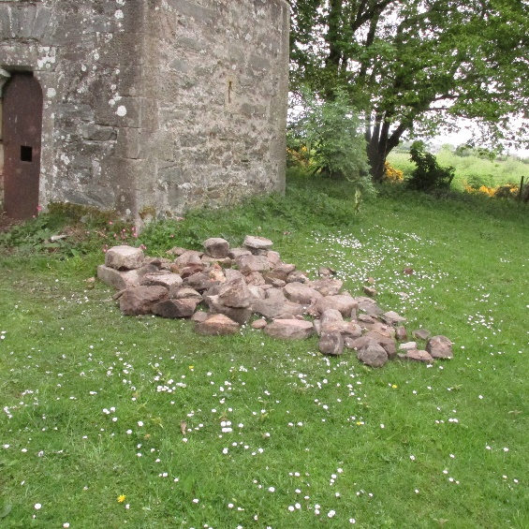
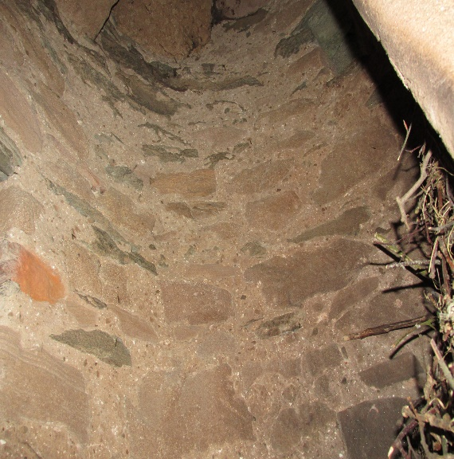
Many years of bird nests and poo! Before & after cleaning the Tower stairs

